Slide 1
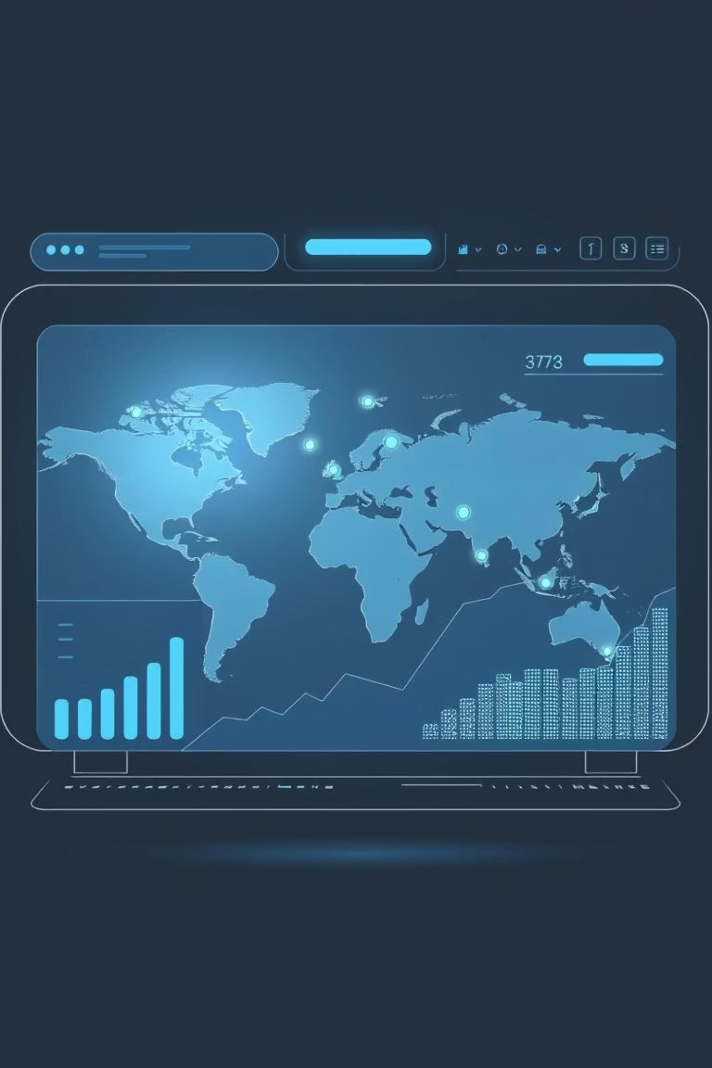
E-commerce Sales Analysis Report
Prepared by: Abhijeet Kanungo
Date: July 18, 2025

Slide 2
Introduction
This report analyzes e-commerce sales data to understand past performance, identify key trends, and uncover insights. It focuses on revenue, customer behavior, and product performance to optimize sales, marketing, and inventory management.

Slide 3
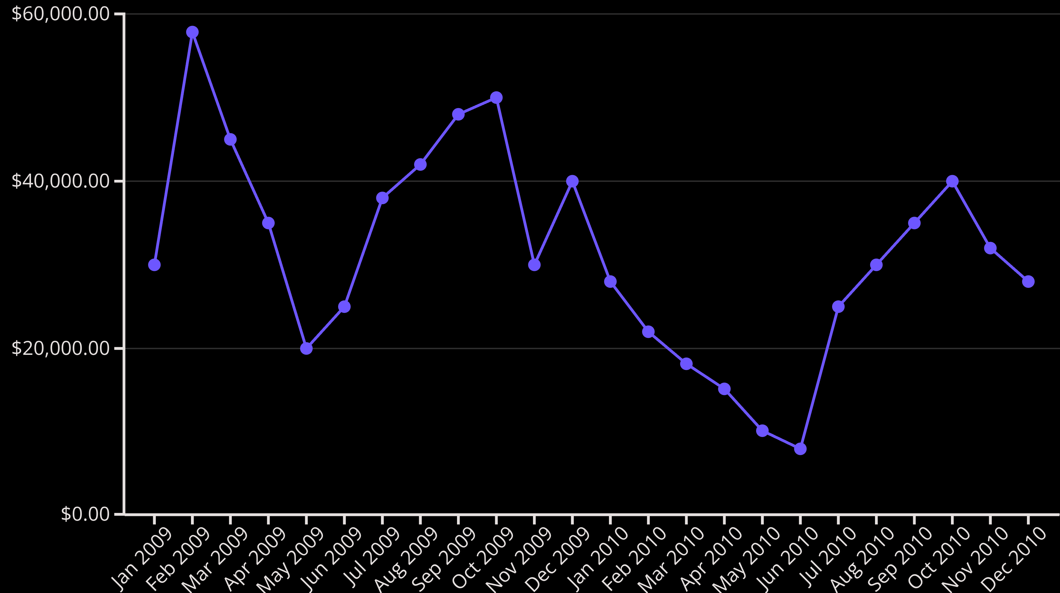
Sales Performance Analysis
Sales revenue shows significant monthly and yearly fluctuations. February 2009 had the highest sales (₹57,871.26), while June 2010 saw the lowest (₹7,832.94). Annual revenue declined over 50% from 2009 (₹430,000) to 2010 (₹205,000).

Slide 4
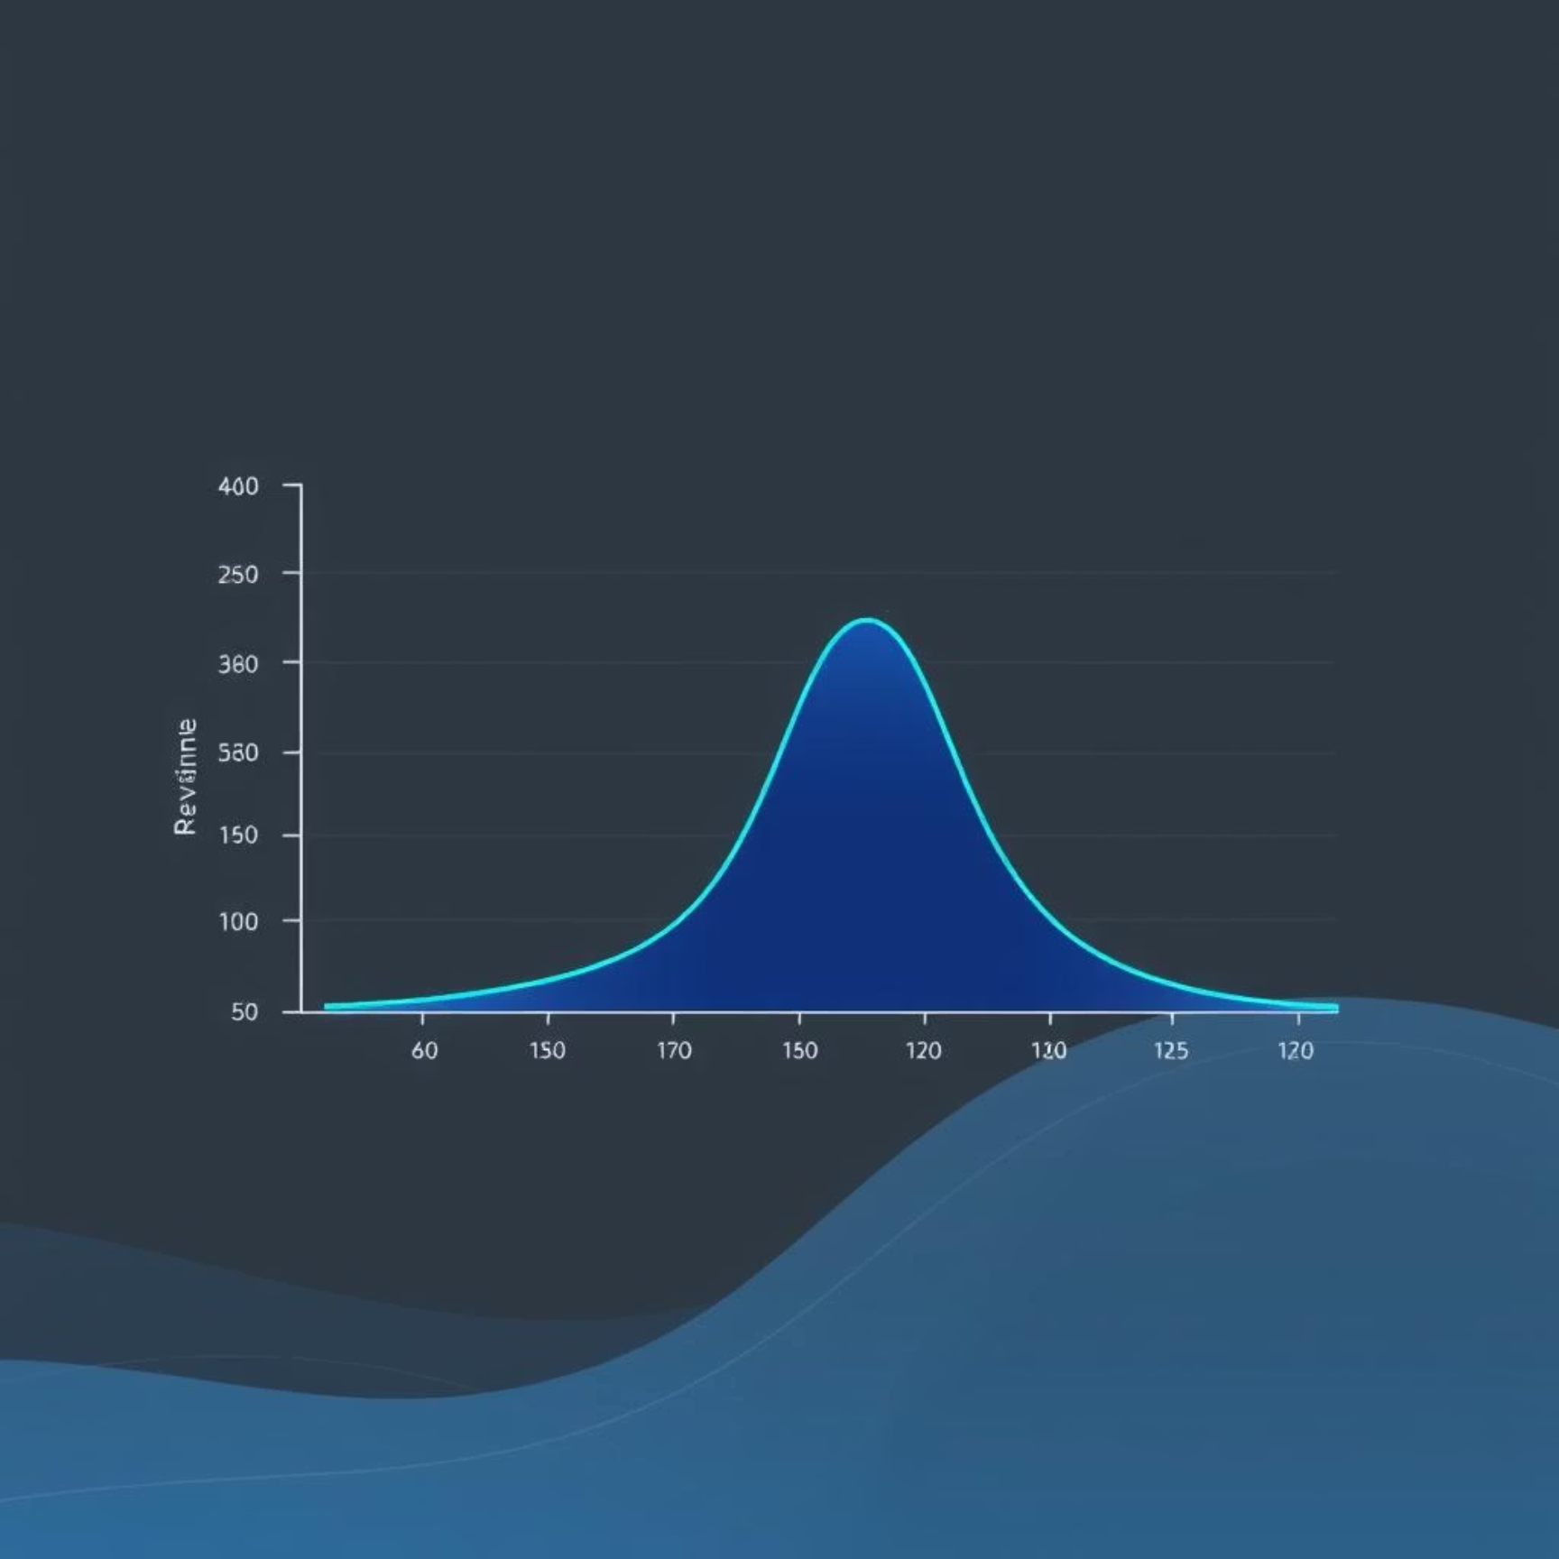
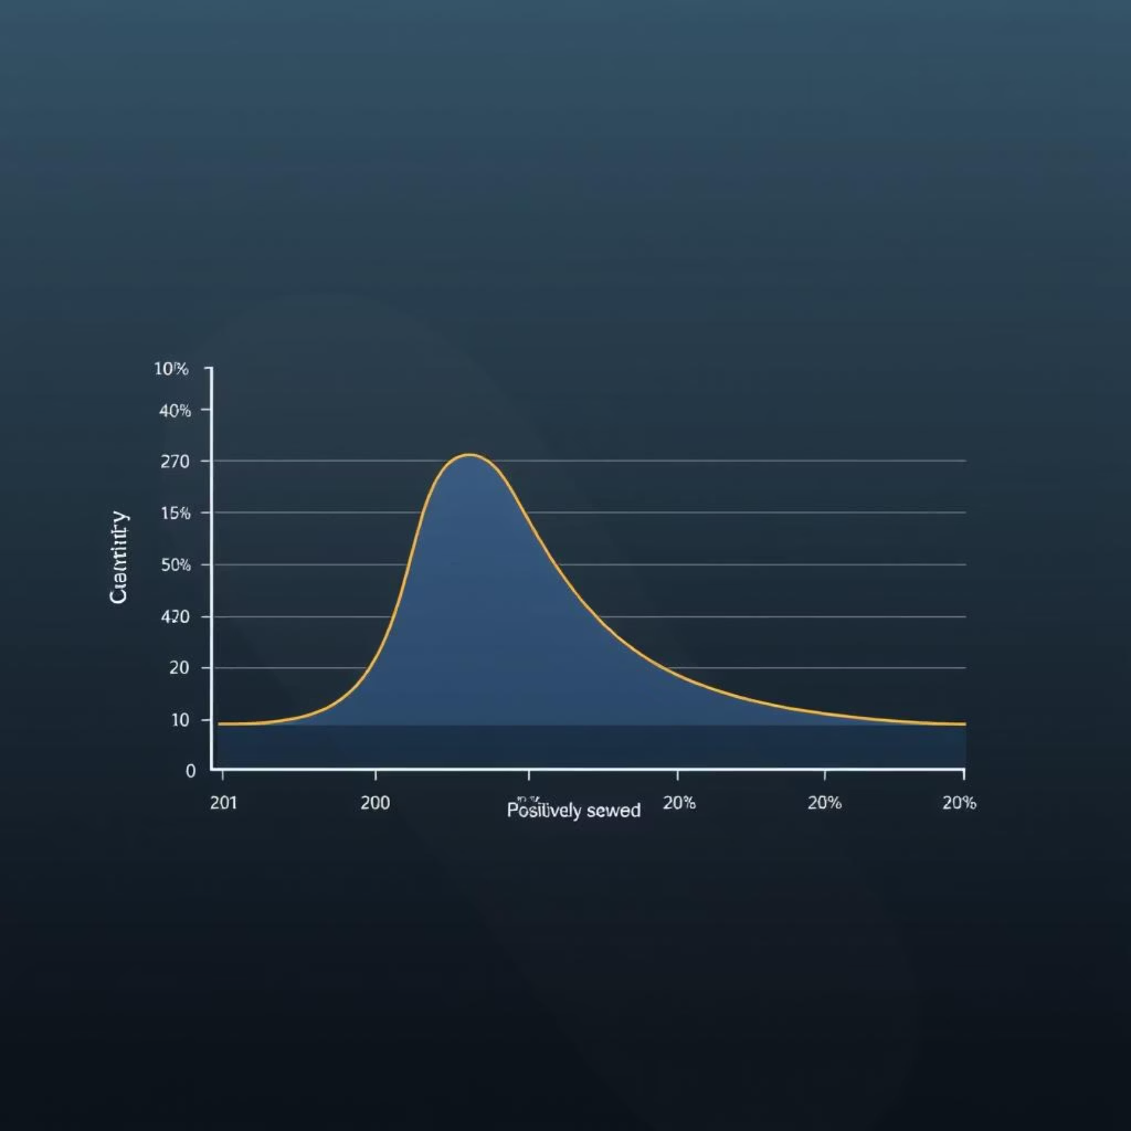
Revenue and Quantity Distribution
Revenue Distribution
Quantity Sold Distribution
Revenue is positively skewed, with high-revenue outliers from large orders disproportionately contributing to total sales.
Quantity sold is also highly skewed; most transactions are small (1-3 items), but significant outliers represent bulk purchases.

Slide 5
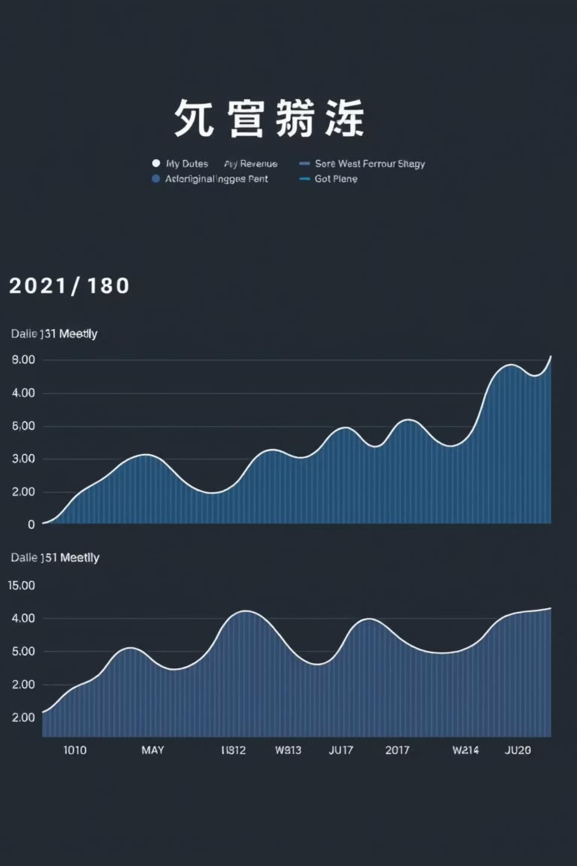


Sales Trend Analysis
Daily Sales
Weekly Sales
Highly volatile with sharp peaks and near-zero sales, suggesting non-continuous operations or batch ordering. Not suitable for forecasting alone.
Smoothed volatility with cyclical peaks, ideal for short-term promotional planning and inventory restocking cycles.
Monthly Sales
Most stable view, indicating seasonal behavior with Q1 and Q3 performing well. Drives strategic planning and budget allocation.

Slide 6
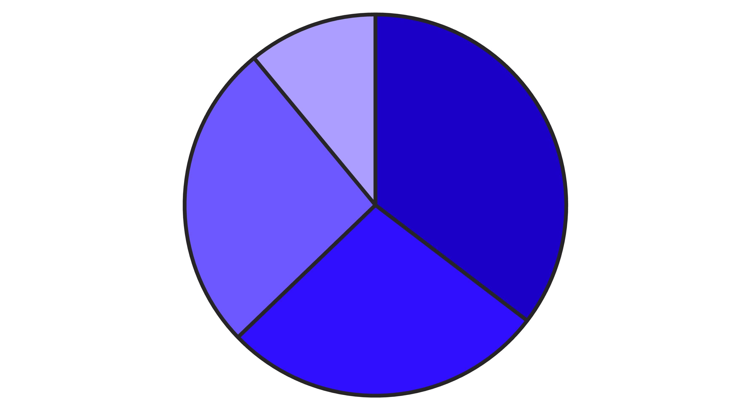
Customer Behavior Insights
Our customer base is segmented by Recency, Frequency, and Monetary (RFM) value.
Champions
Potential
Loyal
At Risk
Champions are our largest segment, while "At Risk" customers need urgent reactivation.

Slide 7
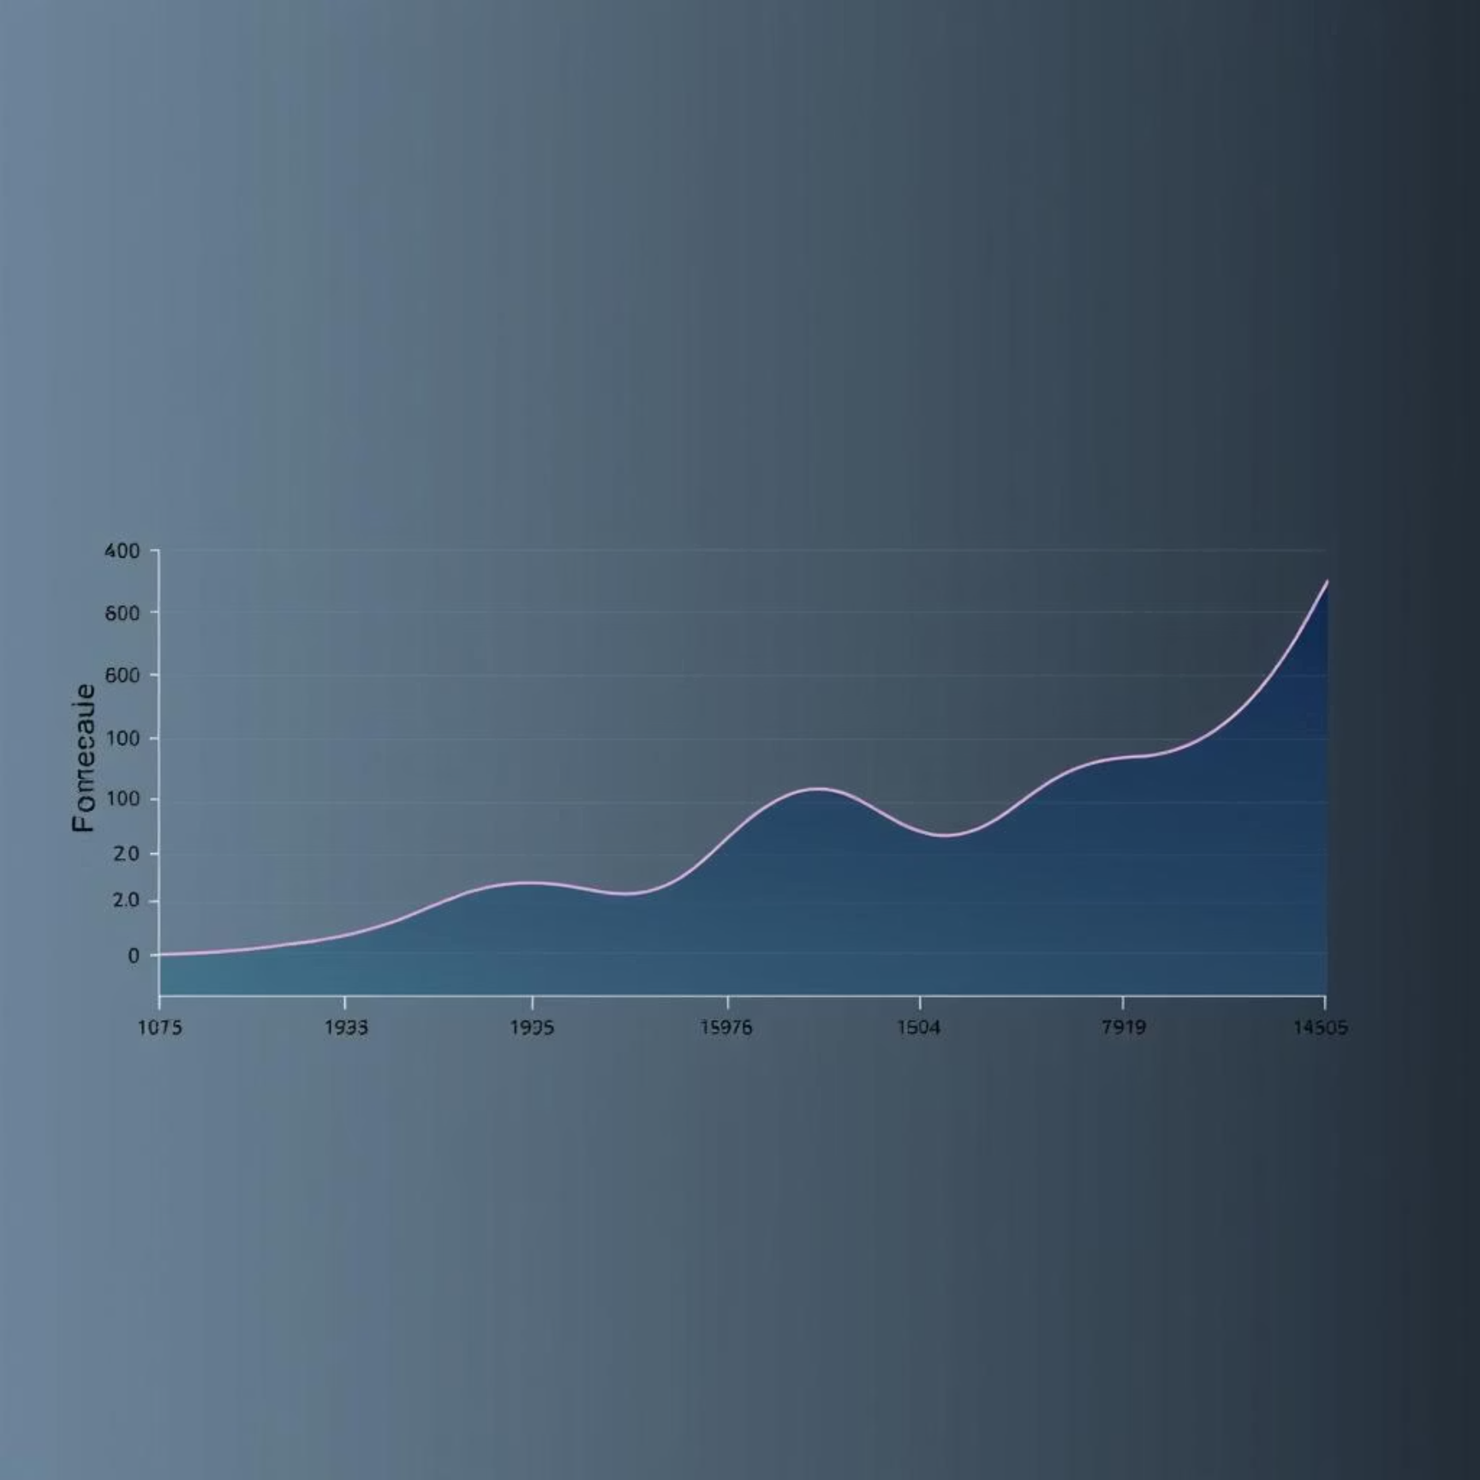
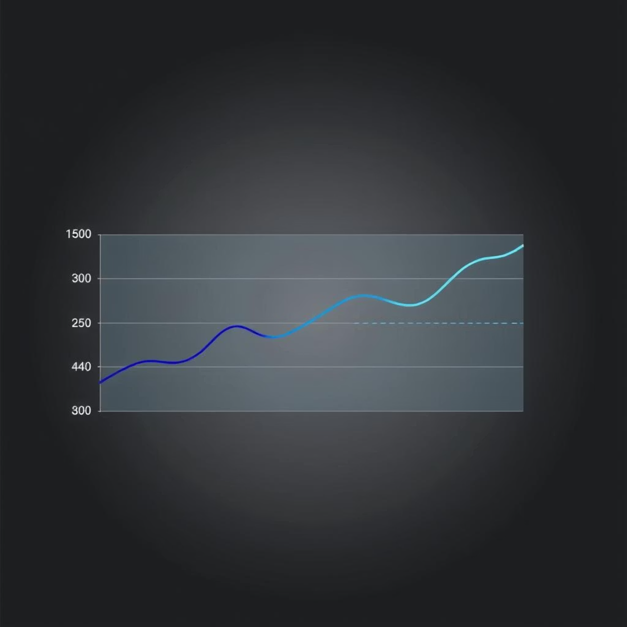
Sales Forecasting Challenges
The Prophet model forecasts a modest, steady trend with fluctuations, but uncertainty increases over time. The model struggles with high variability and sudden sales spikes, often producing inaccurate or negative predictions.
Forecast Using Prophet
Actual vs. Predicted Sales

Slide 8




Identified Business Opportunities
High-Value Transactions
Seasonal Demand
Significant high-revenue and bulk-quantity outliers indicate a segment for growth through nurturing and targeted strategies.
Products with strong seasonal peaks present opportunities for increased sales during specific periods.
Customer Champions
B2B/Reseller Segmentation
A strong base of loyal, high-value customers represents a significant area for sustained growth through retention and advocacy.
Extreme bulk quantity outliers suggest a distinct segment for tailored offerings and new revenue streams.

Slide 9
Recommendations & Action Plan
Q1 2026
Q4 2025
Evaluate B2B programs and campaign impact, then refine inventory and marketing strategies for continuous improvement.
Q3 2025
Launch seasonal marketing campaigns, adjust inventory based on revised forecasts, and initiate re-engagement campaigns for at-risk customers.
Deep dive into customer segmentation, pilot B2B programs, and update forecasting models to handle outliers and seasonality.

Slide 10
Conclusion & Next Steps
Key Takeaways
Expected Impact
Revenue and quantity are skewed by high-value outliers.
Increased revenue by capitalizing on high-value transactions.
Significant sales volatility and a 50%+ decline from 2009 to 2010.
Enhanced customer engagement through personalized marketing.
Diverse product performance and a strong "Champion" customer base.
Improved operational efficiency via accurate forecasting.
Forecasting model struggles with variability and spikes.
Sustained growth and a more resilient business model.

